Slide 1
Public Communication Dr. Clara Ma Have you ever listened to a presenter who sounded super smart – without having any ideas what she really said?

Slide 2

Your reader or audience always wonders…
What’s In It For Them?
(WIIIFT)

Slide 3
And don’t forget the all-important factor: High Skim Value
So how do you get high skim value?

Slide 4


What are we feeding us?

Slide 5


Slide 6
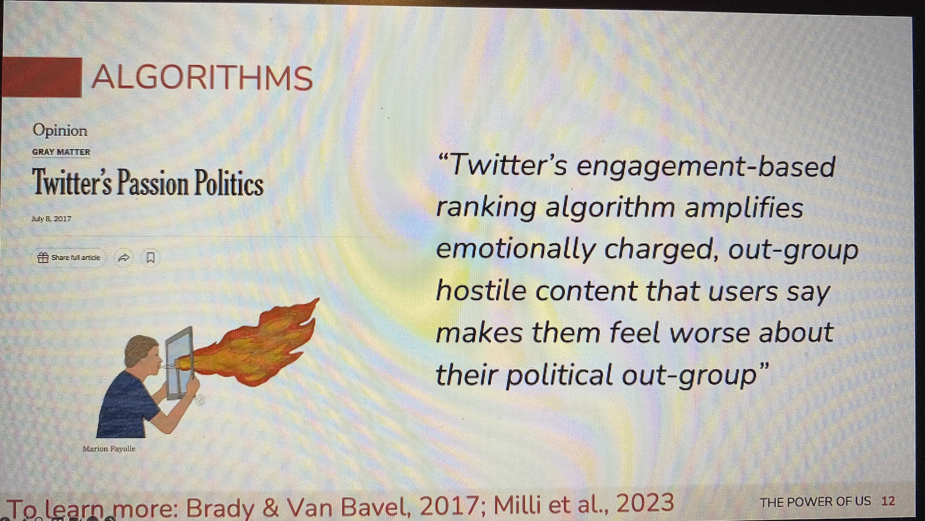

Slide 7
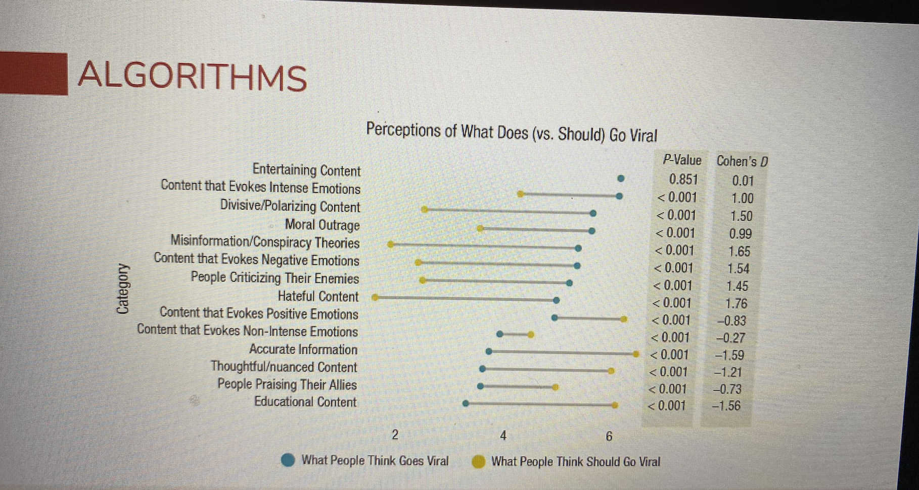

Slide 8
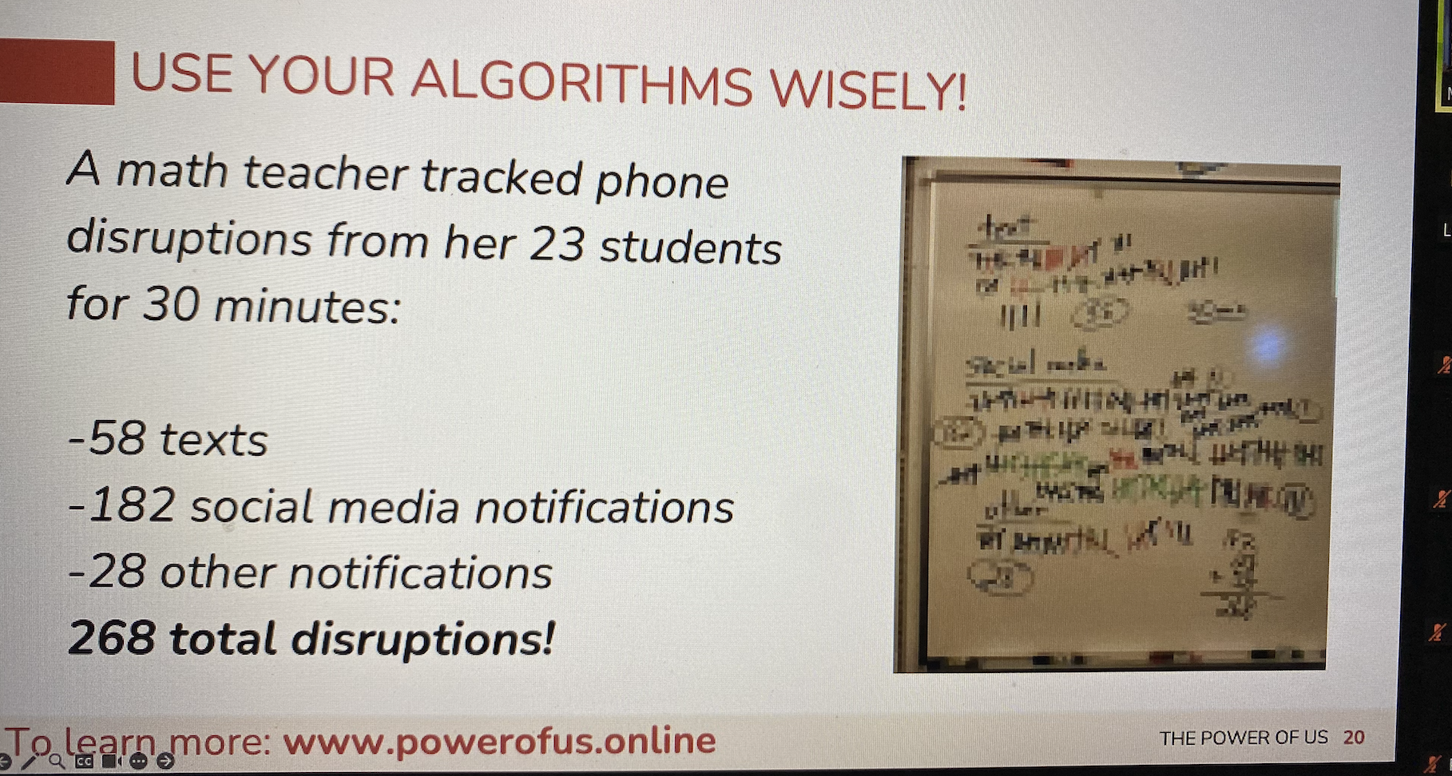

Slide 9
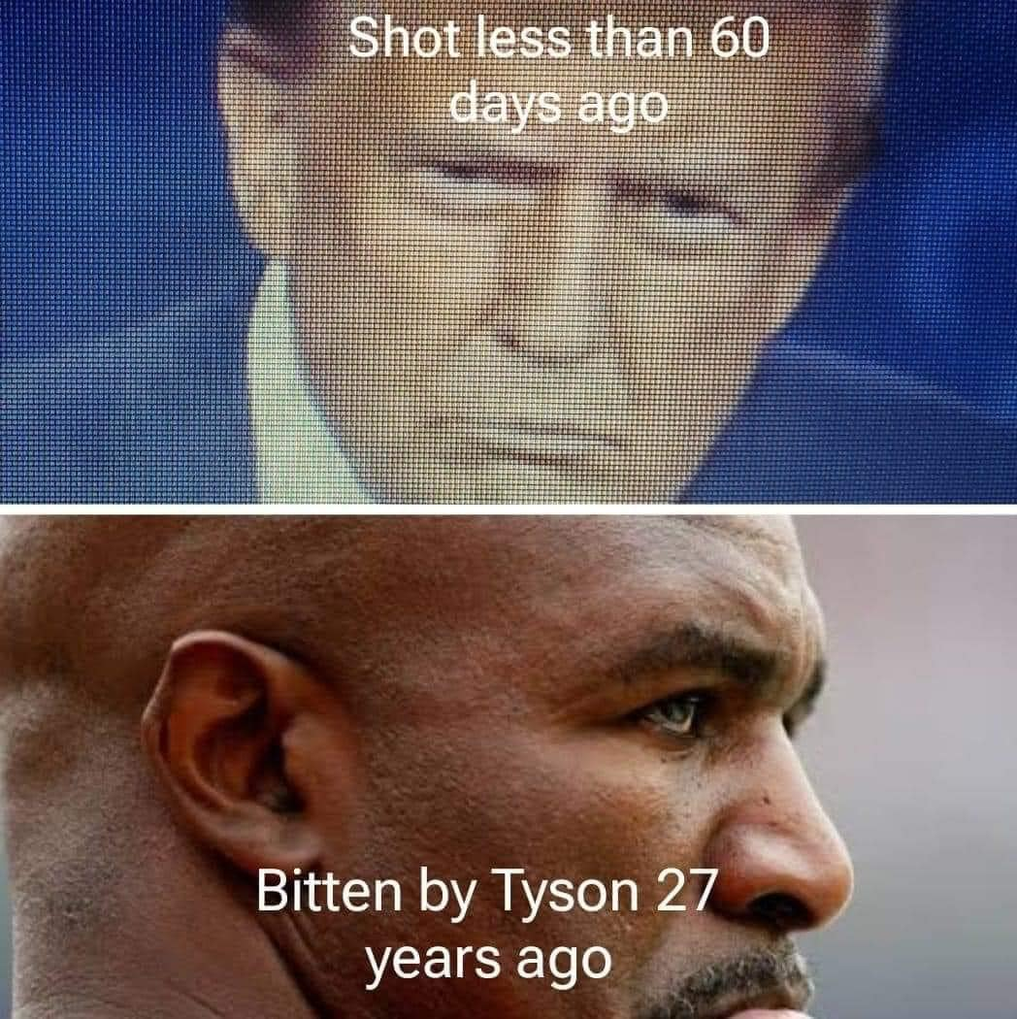
Hateful

Slide 10
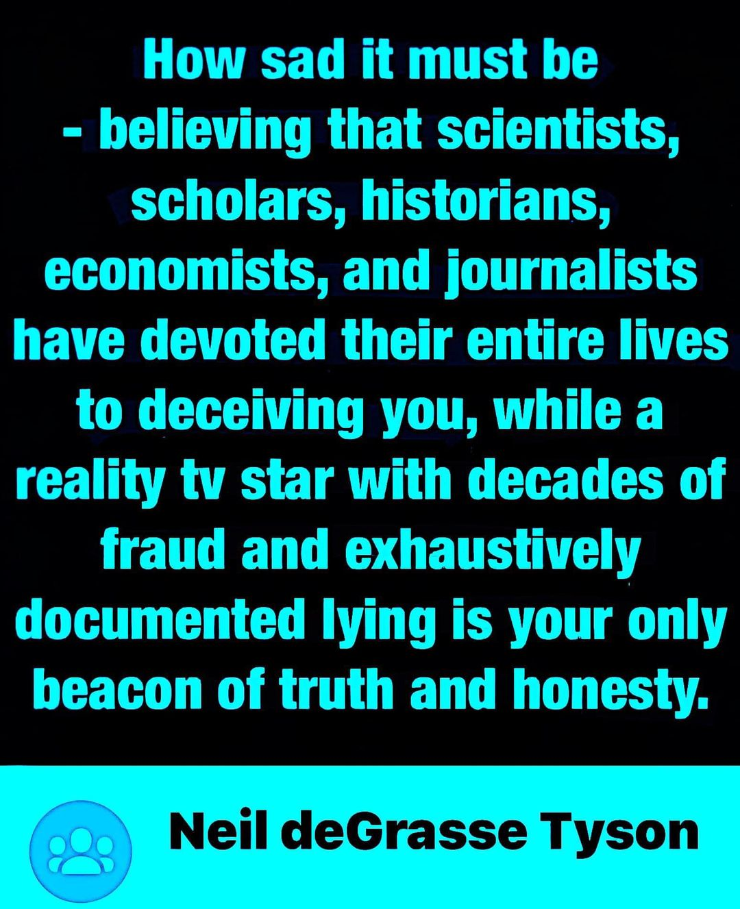

Slide 11
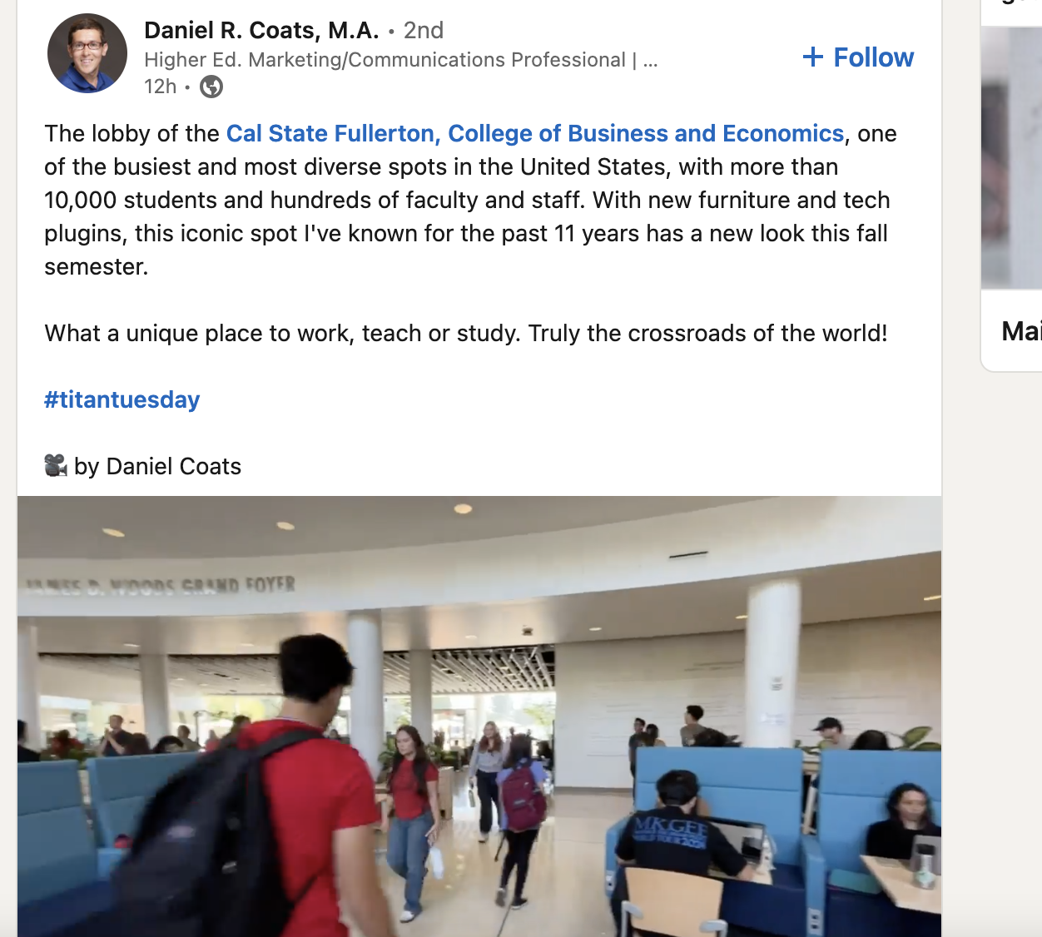
Let’s do some search!

Slide 12
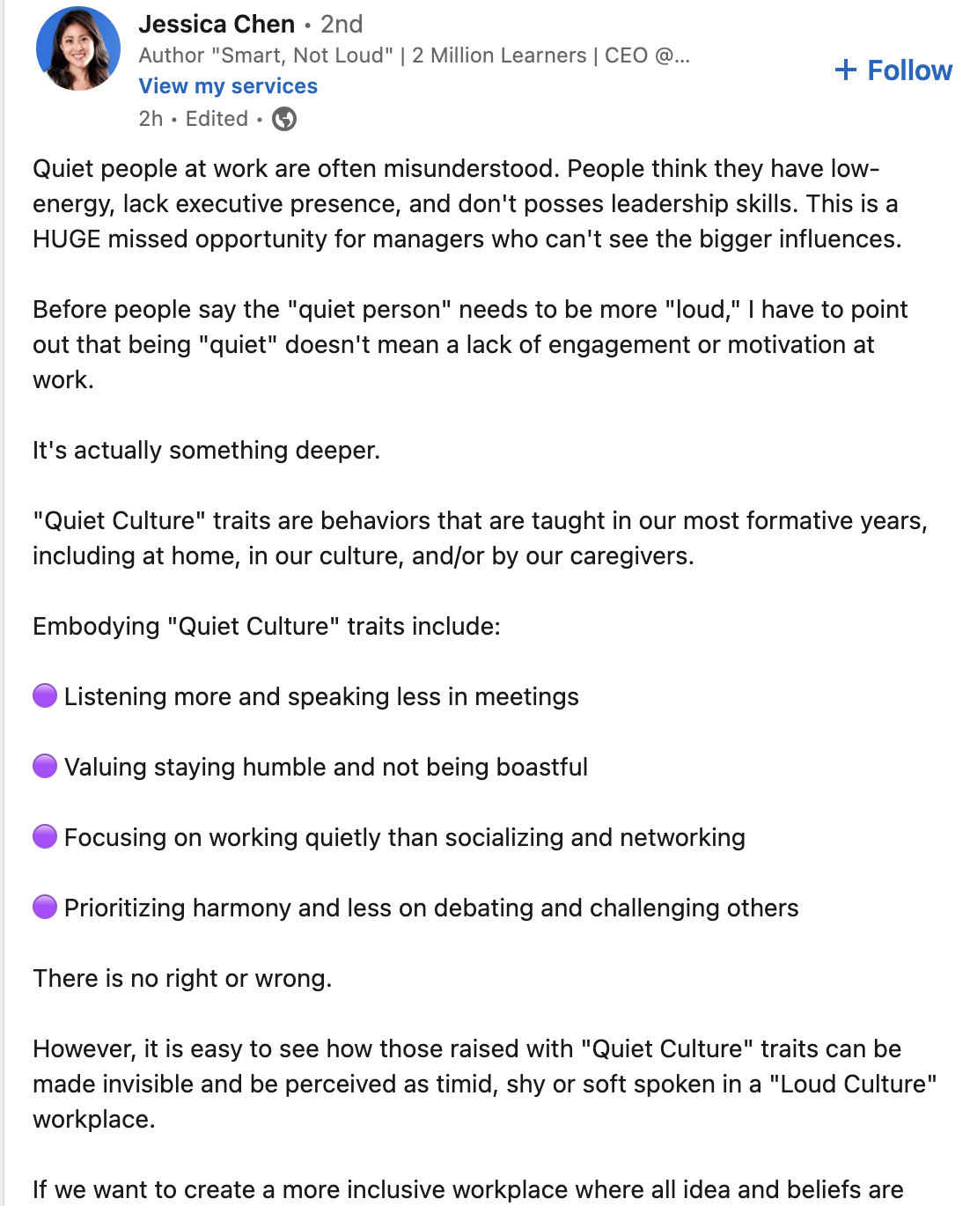

Slide 13
